Slide 1
MEMORY MANAGEMENT IN JAVA
PRESENTED BY
B G AKSHAYA

Slide 2
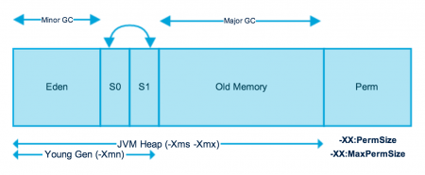
Java (JVM) Memory Model

Slide 3
Eden Space (heap):
The pool from which memory is initially allocated for most objects.
Survivor Space (heap):
The pool containing objects that have survived the garbage collection of the
Eden space.
Tenured Generation (heap): The pool containing objects that have existed for some time in the survivor space.
Permanent Generation (non-heap): The pool containing all the reflective data of the virtual machine itself, such as class and method objects. With Java VMs that use class data sharing, this generation is divided into read-only and read-write areas.
Code Cache (non-heap): The HotSpot Java VM also includes a code cache, containing memory that is used for compilation and storage of native code.

Slide 4
YOUNG GENERATION
Young generation is the place where all the new objects are created. When young generation is filled, garbage collection is performed. This garbage collection is called Minor GC. Young Generation is divided into three parts – Eden Memory and two Survivor Memory spaces.
Most of the newly created objects are located in the Eden memory space.
When Eden space is filled with objects, Minor GC is performed and all the survivor objects are moved to one of the survivor spaces.
Minor GC also checks the survivor objects and move them to the other survivor space. So at a time, one of the survivor space is always empty.
Objects that are survived after many cycles of GC, are moved to the Old generation memory space. Usually it’s done by setting a threshold for the age of the young generation objects before they become eligible to promote to Old generation.

Slide 5
OLD GENERATION
Old Generation memory contains the objects that are long lived and survived after many rounds of Minor GC. Usually garbage collection is performed in Old Generation memory when it’s full.
Typically, a threshold is set for young generation object and when that age is met, the object gets moved to the old generation.
Old Generation Garbage Collection is called Major GC and usually takes longer time.
PERMANENT GENERATION
Permanent Generation or “Perm Gen” contains the application metadata required by the JVM to describe the classes and methods used in the application. The Perm Gen is not part of Java Heap memory.
Perm Gen is populated by JVM at runtime based on the classes used by the application. Perm Gen also contains Java SE library classes and methods. Perm Gen objects are garbage collected in a full garbage collection.

Slide 6
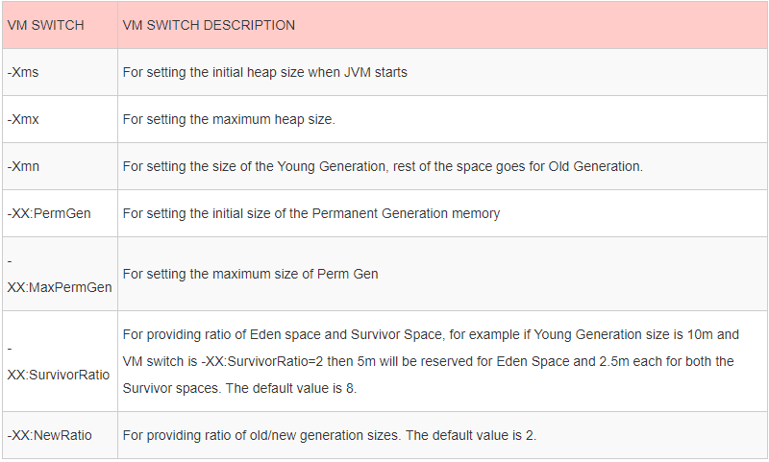
Java Heap Memory Switches
Java provides a lot of memory switches that we can use to set the memory sizes and their ratios.

Slide 7
GARBAGE COLLECTION
Java Garbage Collection is the process to identify and remove the unused objects from the memory and free space to be allocated to objects created in the future processing. One of the best feature of java programming language is the automatic garbage collection, unlike other programming languages such as C where memory allocation and deallocation is a manual process.
Garbage Collector is the program running in the background that looks into all the objects in the memory and find out objects that are not referenced by any part of the program. All these unreferenced objects are deleted and space is reclaimed for allocation to other objects.
An in use object, or a referenced object, means that some part of your program still maintains a pointer to that object. An unused object, or unreferenced object, is no longer referenced by any part of your program. So the memory used by an unreferenced object can be reclaimed.

Slide 8
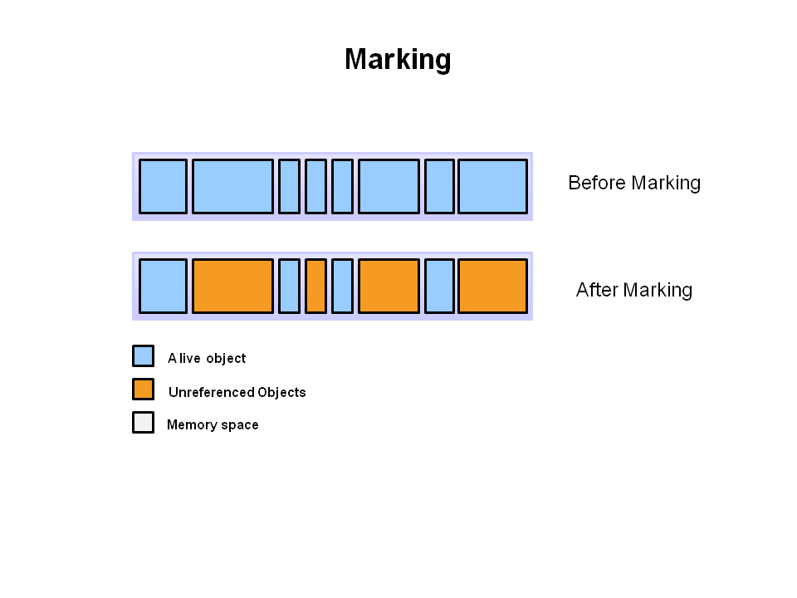
Step 1 : Marking: This is the first step where garbage collector identifies which objects are in use and which ones are not in use.
All objects are scanned in the marking phase to make this determination. This can be a very time consuming process if all objects in a system must be scanned.

Slide 9
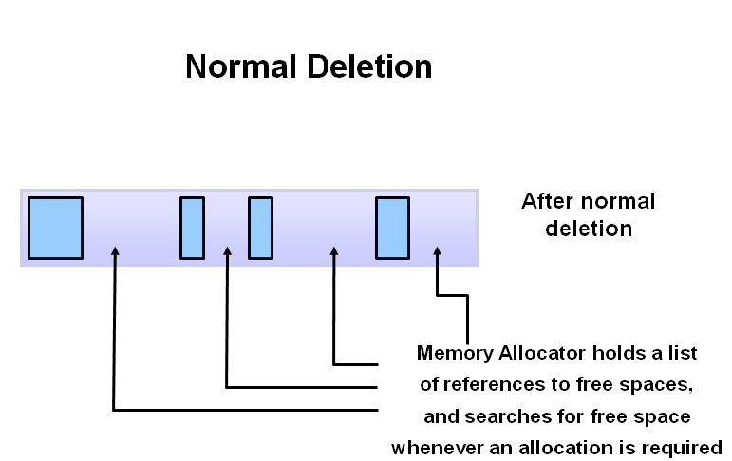
Step 2 : Normal Deletion: Garbage Collector removes the unused objects and reclaim the free space to be allocated to other objects. Normal deletion removes unreferenced objects leaving referenced objects and pointers to free space.

Slide 10
Step 2 : Normal Deletion: Garbage Collector removes the unused objects and reclaim the free space to be allocated to other objects. Normal deletion removes unreferenced objects leaving referenced objects and pointers to free space.

Slide 11
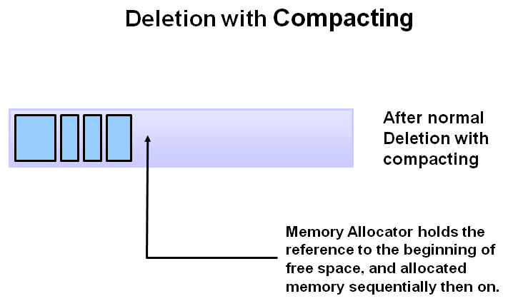
Step 3: Deletion with Compacting: To further improve performance, in addition to deleting unreferenced objects, you can also compact the remaining referenced objects. By moving referenced object together, this makes new memory allocation much easier and faster.

Slide 12
TYPES OF GARBAGE COLLECTION
Serial Garbage Collector
Serial garbage collector works by holding all the application threads. It is designed for the single-threaded environments. It uses just a single thread for garbage collection. The way it works by freezing all the application threads while doing garbage collection may not be suitable for a server environment. It is best suited for simple command-line programs.
2. Parallel Garbage Collector
Parallel garbage collector is also called as throughput collector. It is the default garbage collector of the JVM. Unlike serial garbage collector, this uses multiple threads for garbage collection. Similar to serial garbage collector this also freezes all the application threads while performing garbage collection.

Slide 13
TYPES OF GARBAGE COLLECTION
3. CMS Garbage Collector
Concurrent Mark Sweep (CMS) garbage collector uses multiple threads to scan the heap memory to mark instances for eviction and then sweep the marked instances. CMS garbage collector holds all the application threads in the following two scenarios only,
while marking the referenced objects in the tenured generation space.
if there is a change in heap memory in parallel while doing the garbage collection.
In comparison with parallel garbage collector, CMS collector uses more CPU to ensure better application throughput. If we can allocate more CPU for better performance then CMS garbage collector is the preferred choice over the parallel collector.
4. G1 Garbage Collector
G1 garbage collector is used for large heap memory areas. It separates the heap memory into regions and does collection within them in parallel. G1 also does compacts the free heap space on the go just after reclaiming the memory. But CMS garbage collector compacts the memory on stop the world (STW) situations. G1 collector prioritizes the region based on most garbage first.

